Slide 1

Date: Wed, 18th December, 2019
Smart-Home Security System
Implemented By
Truong Hong Duc
Tran Thi Thuy Hang
Pham Thuy Tien
Supervisor:
Dr. Phan Van Vinh
Time: 08h00 – 11h30

Slide 2
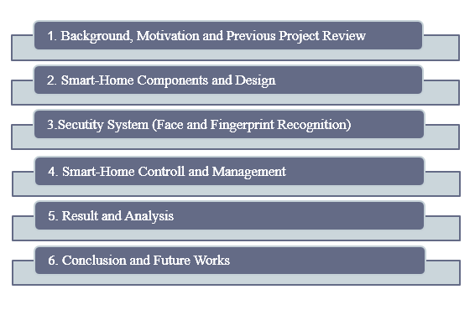
Contents

Slide 3
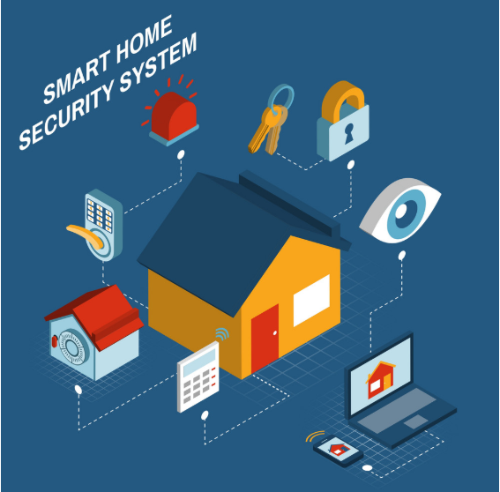
Introduction
Background, Motivation and Previous Project Review
Background Information and Motivation
Notes:
Development in technology from last few decades’ open doors to various threats to human which causes different interruption recognition framework built up for reserve gatecrashers from home condition and give substantial advantages to clients, however can likewise open clients to huge security hazard

Slide 4
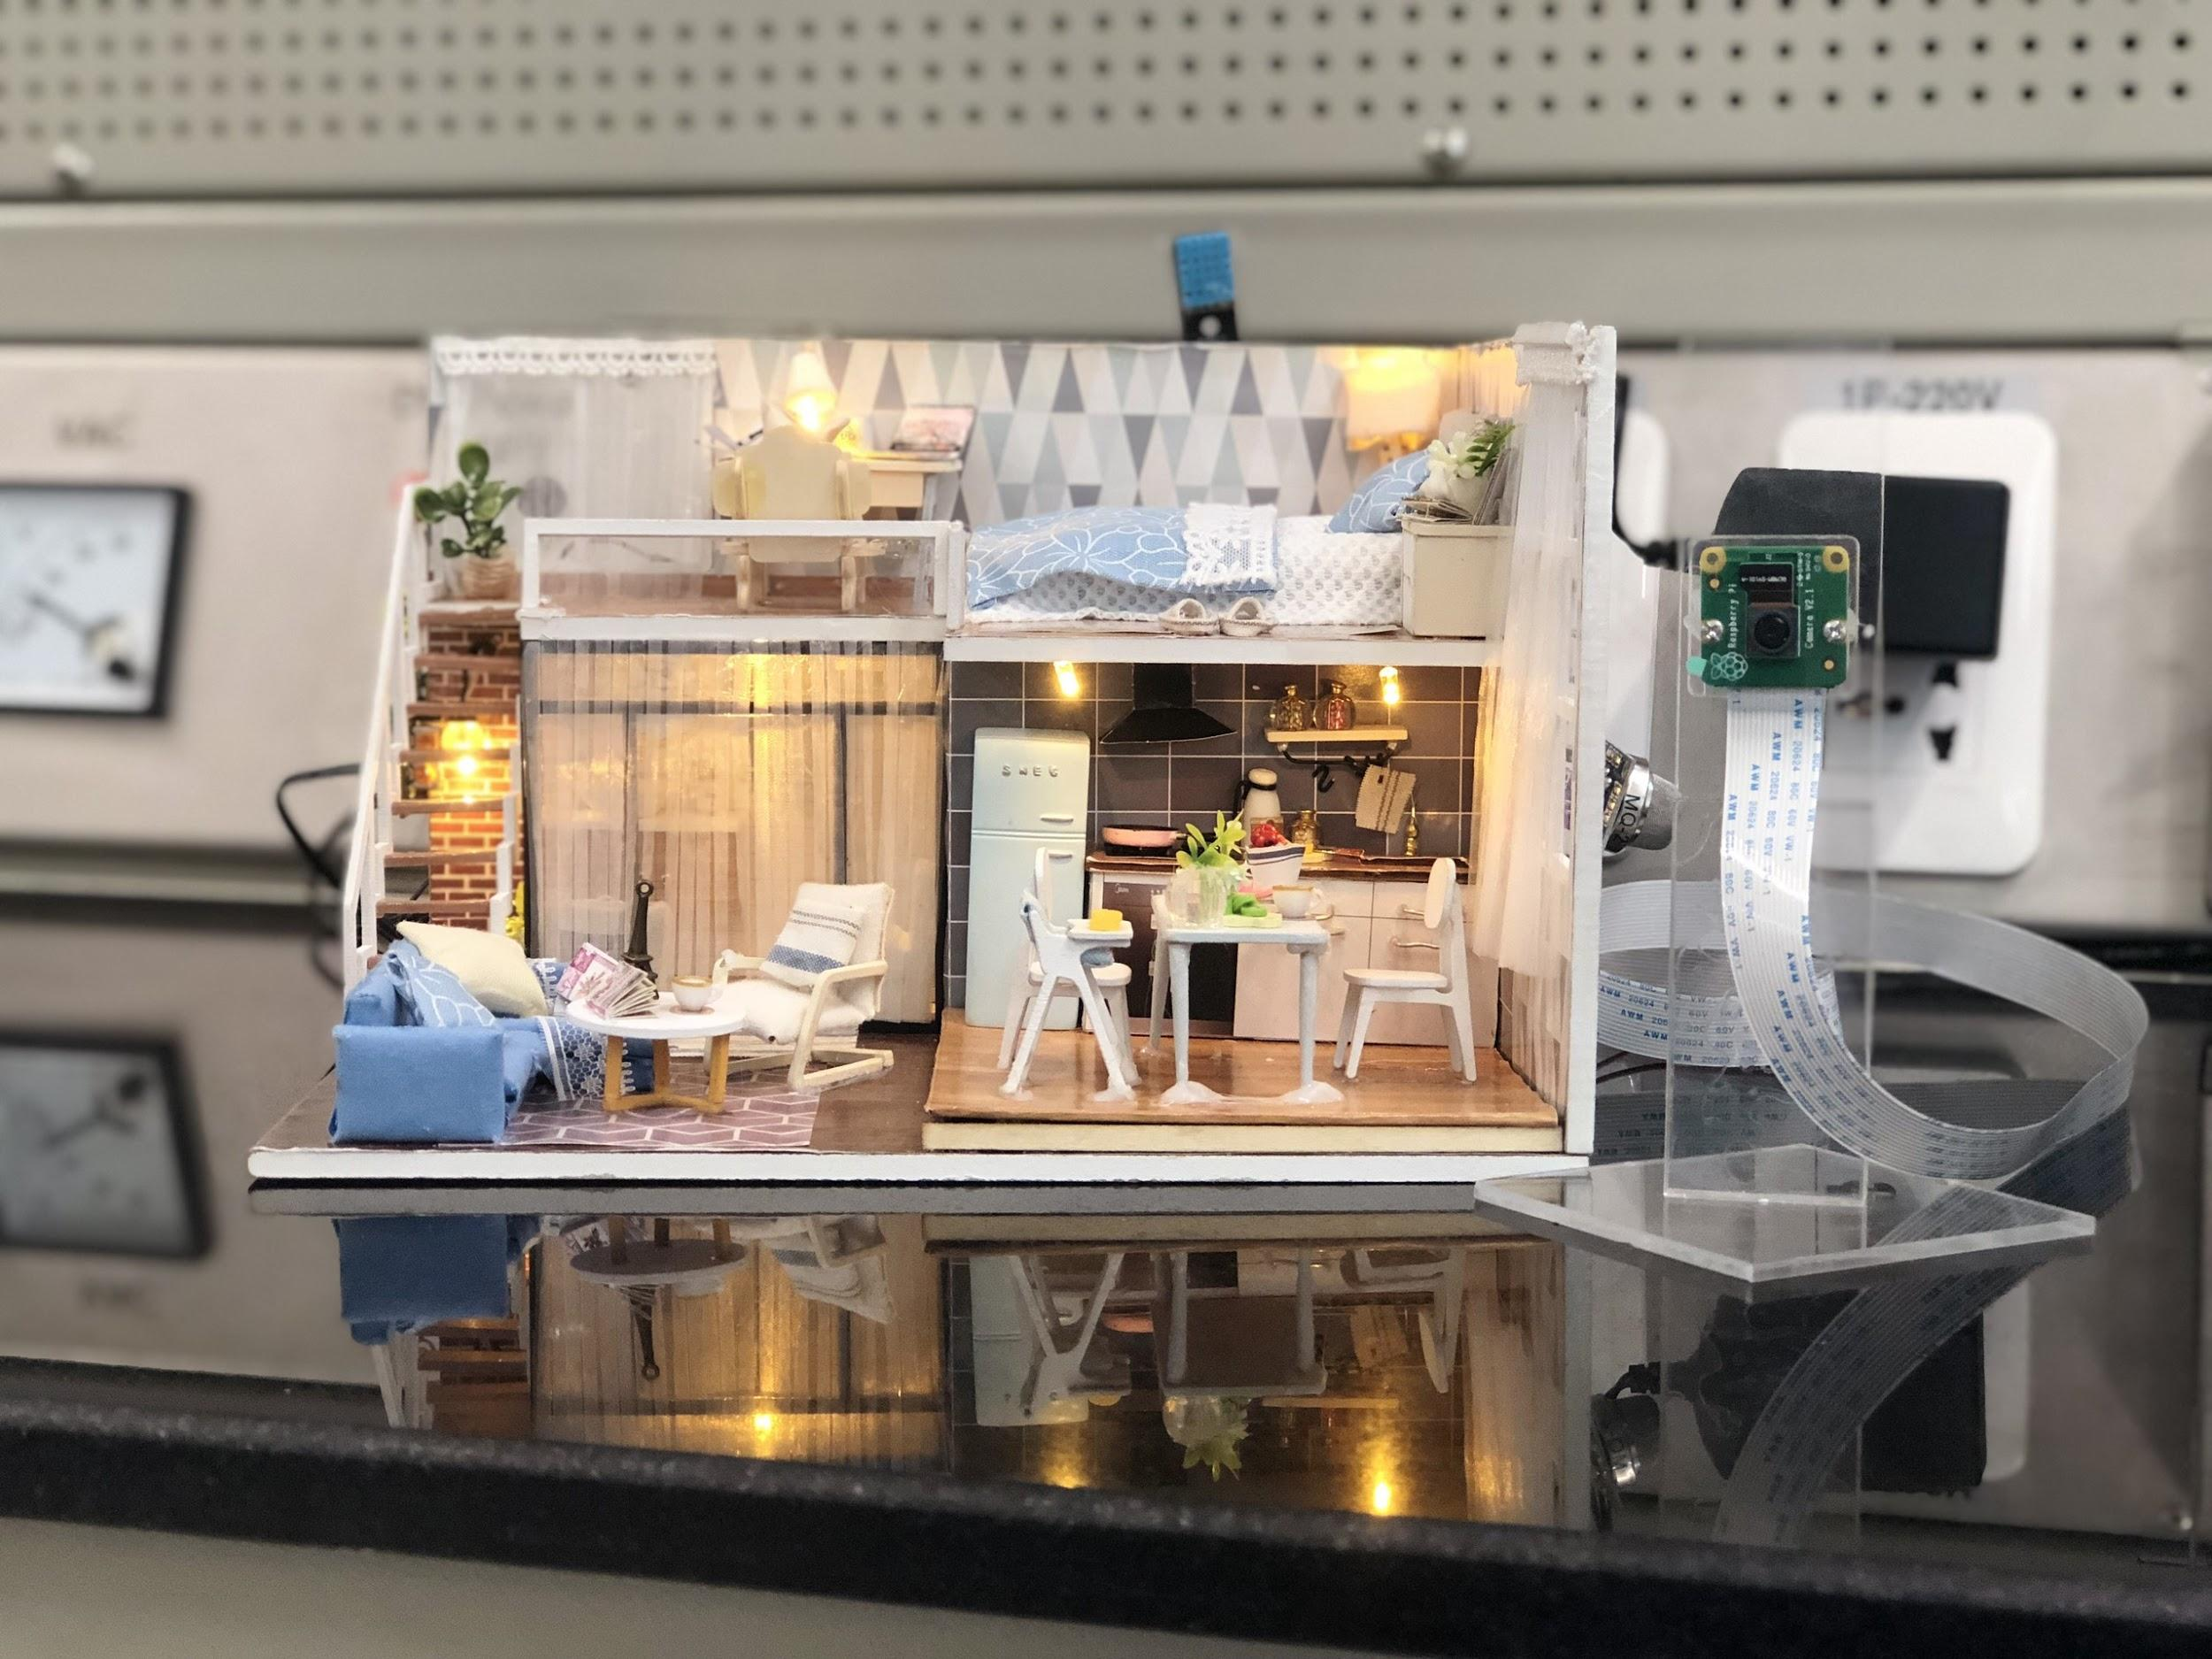
Deployed a Simple Smart-home Model, which devices were controlled by Web Application. Some sensors were set up to measure the data from the environment then stored in the database and displayed on Web Application. Deployed a surveillance system (streaming video) to help users controlling their house.
Background, Motivation and Previous Project Review
Previous Project Review

Slide 5
Background and Motivation
Project’s objectives
Build a Web Application to control system
Collect and Analize data from sensors
Deploy Surveillence System
Deploy Security System

Slide 6
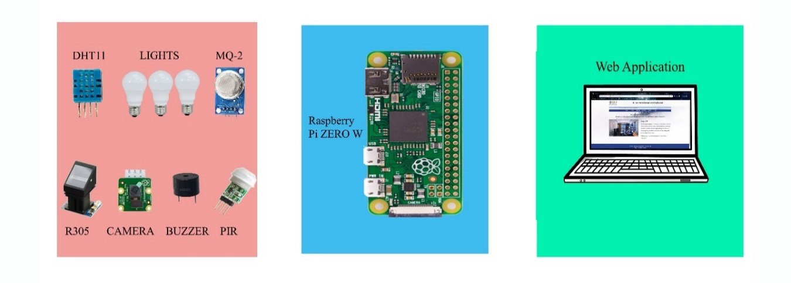
Smart-Home Components and Design
System Architecture

Slide 7
1. Face Recognition 2. Fingerprint Recognition 3. Pushbullet
Smart-home Security System

Slide 8
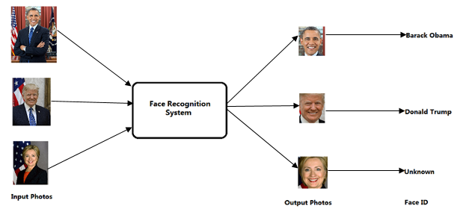
Security System – Face Recognition
Face Recogniton Problems and Its Applications
Face Recognition Problem:
Face Recognition Applications:
- Street view image
- Automatic inspection and supervision.
- Search and recover photos / videos
- Interactive art installation

Slide 9
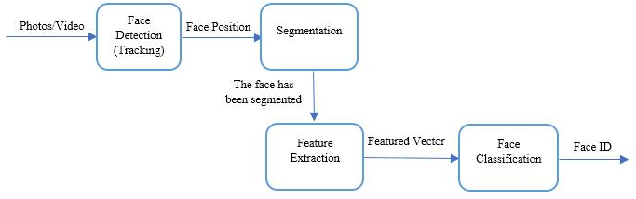
Security System – Face Recognition
Face Recognition System Processing

Slide 10

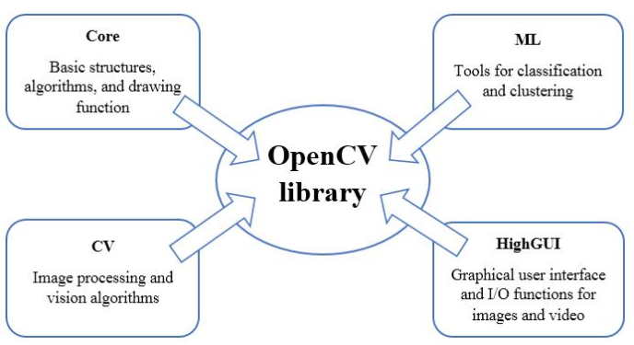
Security System – Face Recognition
OpenCV
Basic Structure of OpenCv Library.

Slide 11
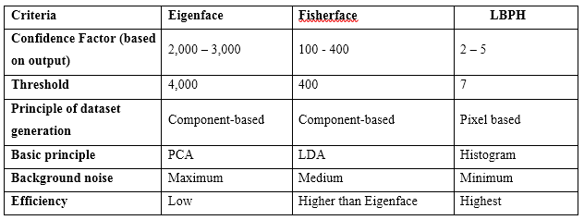
Security System – Face Recognition
OpenCV
Face Recognition Algorithm Comparison.

Slide 12
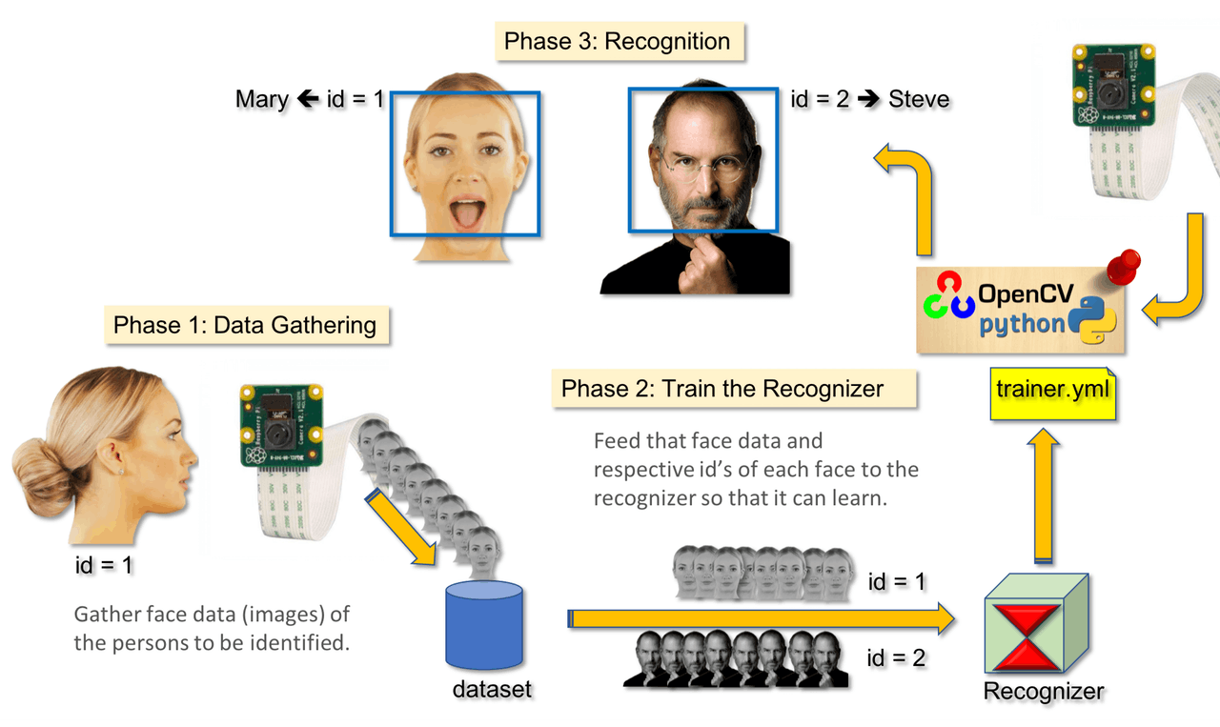

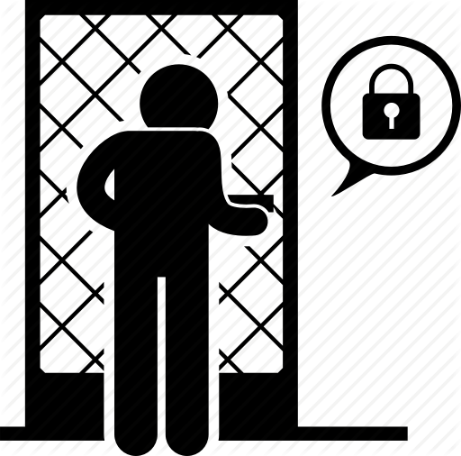

Security System – Face Recognition
Face Recognition System Phases
Phase 4: Door Security Process
ACCEPT
REJECT
Phase 5: Send Security Message

Slide 13

Security system – Fingerprint Recognition
What is fingerprint?
- Fingerprinting is one form of biometrics.
- Fingerprints are unique and never change.
Fingerprint Applications:
- In the criminal justice realm.
- In providing biometric security to control access to secure areas or systems.
- In the field of HR management,

Slide 14
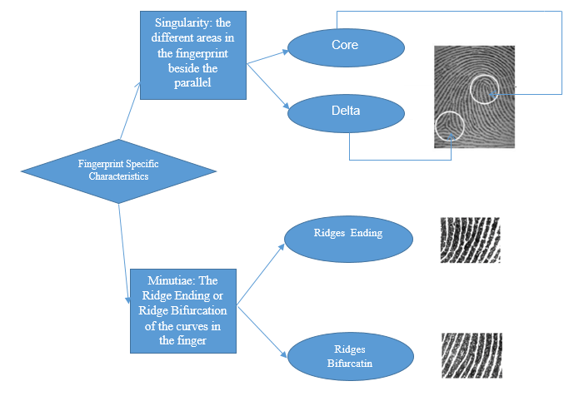
Security system – Fingerprint Recognition
Fingerprint Specific Characteristics

Slide 15
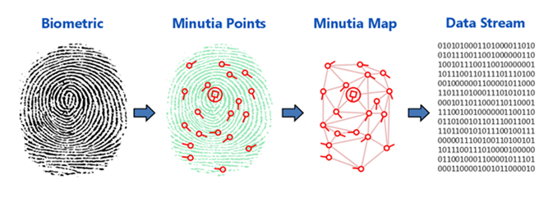
Security system – Fingerprint Recognition
Fingerprint Patterns Extraction Process
Notes:
When a fingerprint is captured, the system locates the minutia. These minutia points occur where the lines of the ridges begin, end, branch off and merge with other ridge lines. These minutia points are created when the lines of the ridges begin, end, branch off and merge with other ridges. These points are mapped by drawing a line between each points, which are called minutia map. The map is stored as a data stream called a minutia template in a database.

Slide 16
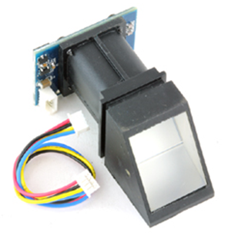
Security system – Fingerprint Recognition
Fingerprint R305 sensor module
Technical specifications:
Power: 3.6-6 VDC.
Communication: TTL-UART or USB 1.1.
Identification mode: 1:1 or 1: N.
Baudrate: 9600xN bps (default N=6 as 9600x6 = 57600bps).
Character File Size: 256 bytes.
Image acquiring time: <0.5s.
Storage capacity: 120 Security level: 5 (1, 2, 3, 4, 5(highest)).
FAR: <0.001%.
FRR: <0.1%.
Average identification time: < 0.8s (1:880).
Size: 18mm*22mm.
Operating temperature and humidity: -10 to 40 C, RH: 40%-85%.

Slide 17
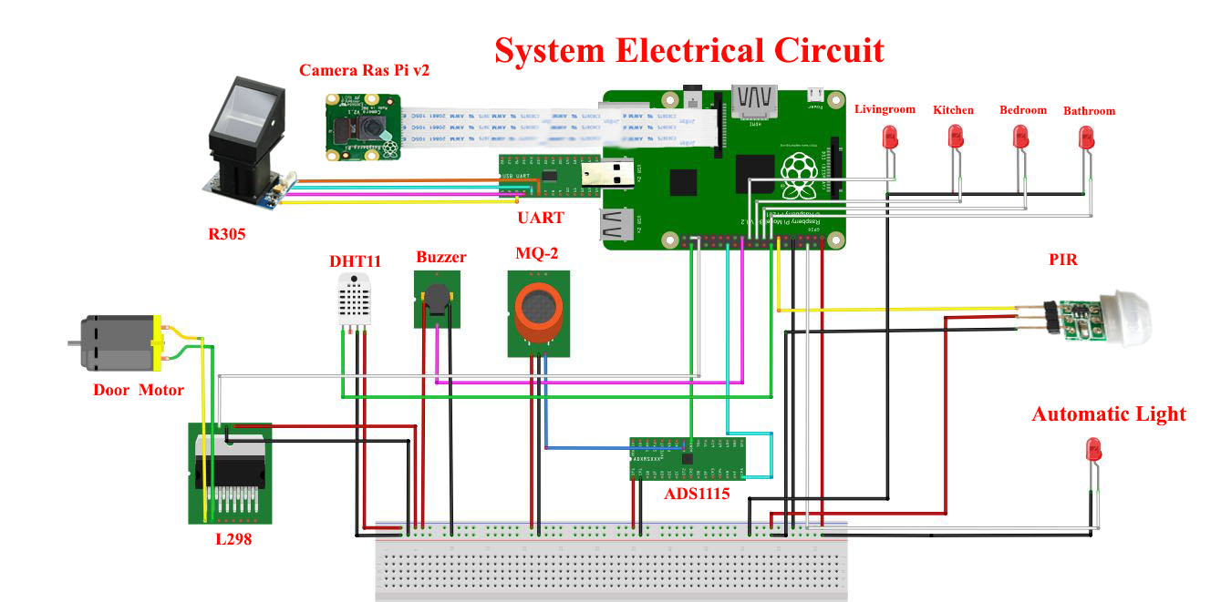
Security system
Smart - Home Connection Diagram

Slide 18
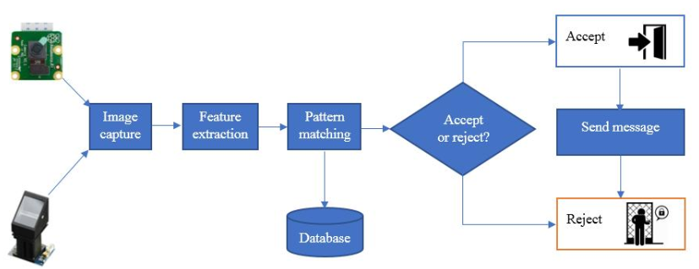
Security system
Smart - Home Security Process

Slide 19
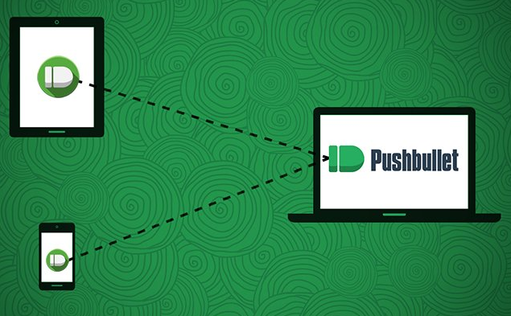
Security system – PushBullet
What is Pushbullet?
Pushbullet is an app for your phone and a Chrome extension for your computer.

Slide 20
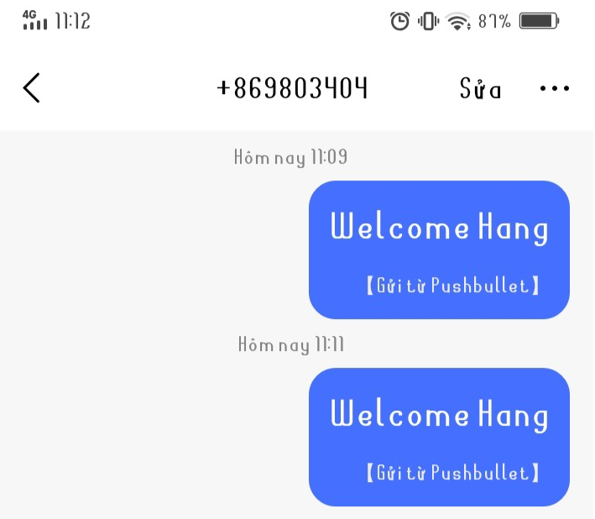
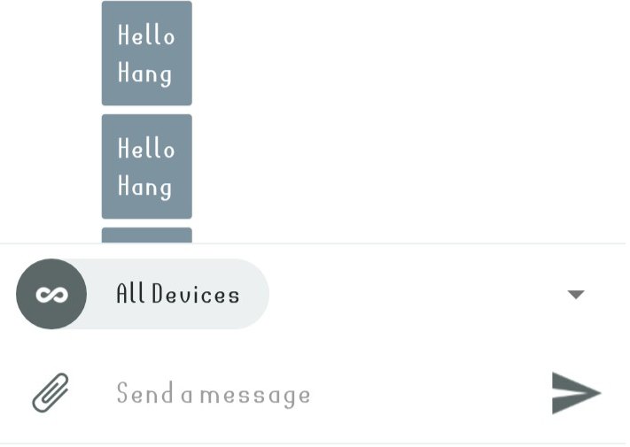
Security system – PushBullet
What does Pushbullet do?
Share files and links between from one device to another.
See your phone’s notifications on your PC. It basically mirrors all notifications from your phone on your PC.
Send SMS messages from your computer.
Access files on other devices.

Slide 21




Smart-Home Controll and Management
Services for Web Application
Apache
MySQL
phpMyAdmin
PHP

Slide 22
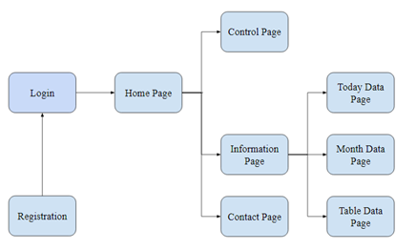
Smart-Home Controll and Management
Web Application
Web Diagram

Slide 23
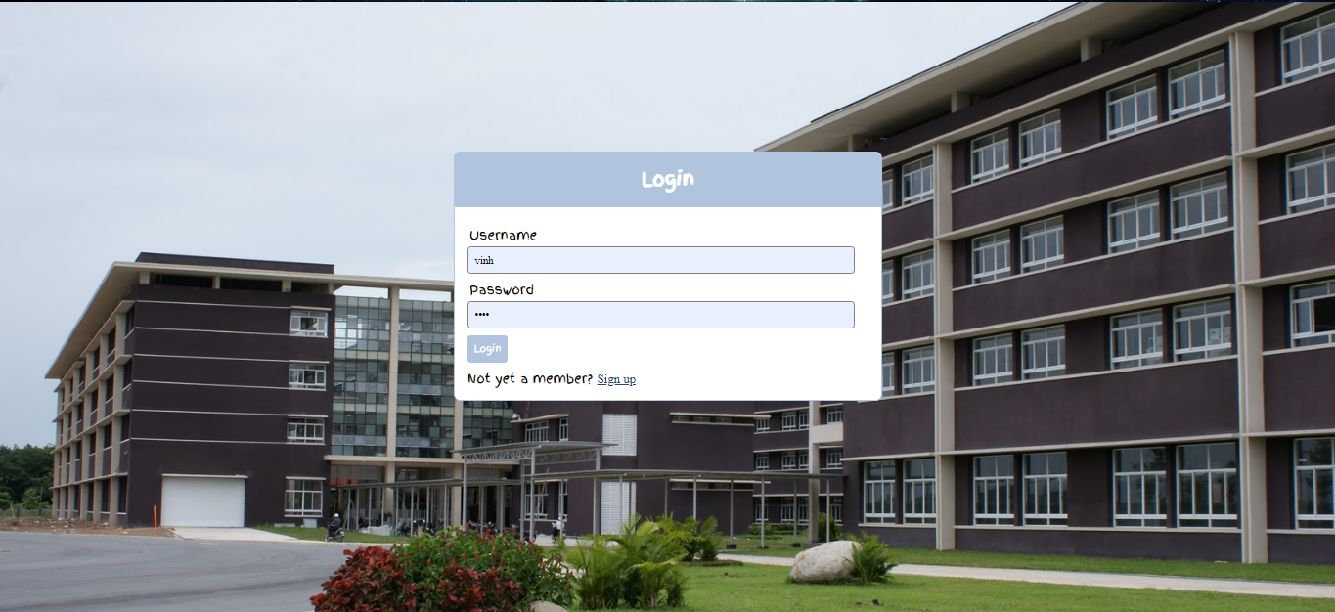
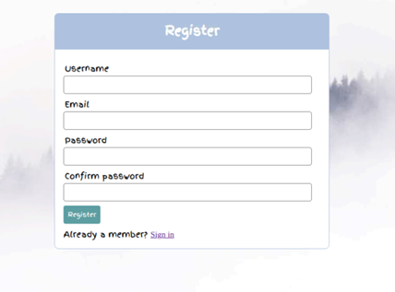
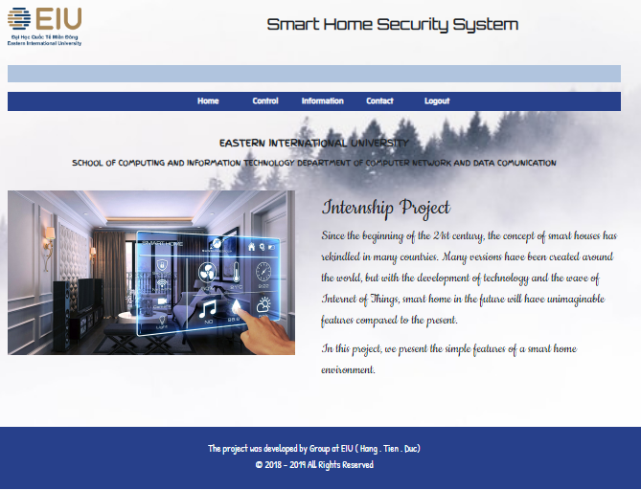
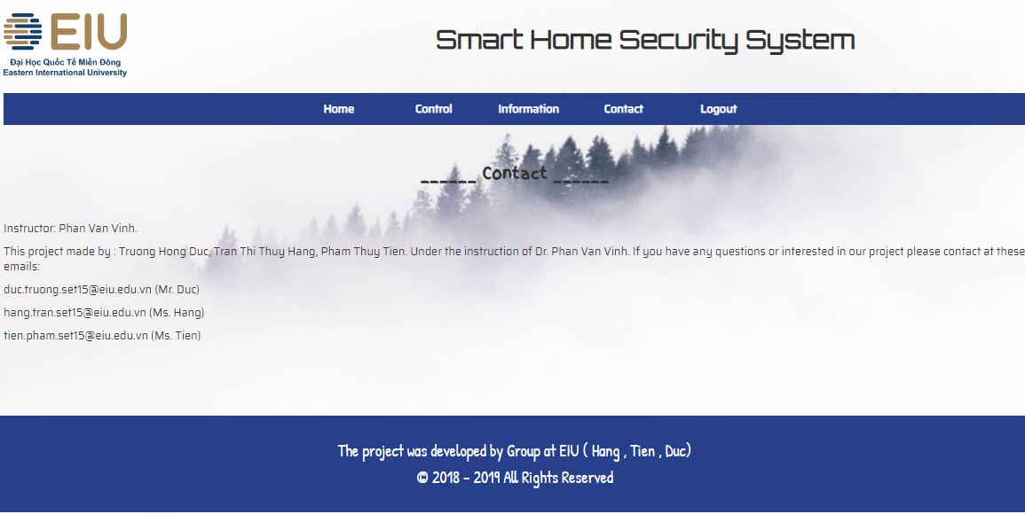
Results and Analysis
Web Application

Slide 24
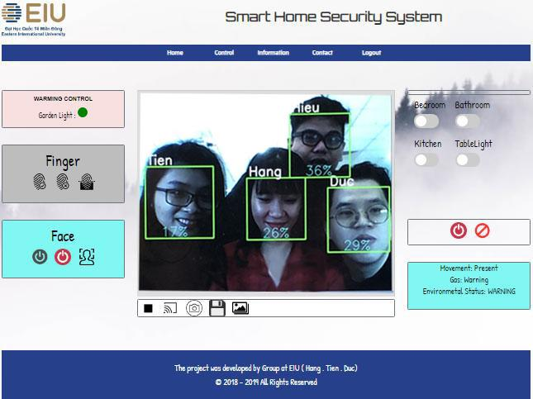
Results and Analysis
Web Application
Control Monitor

Slide 25
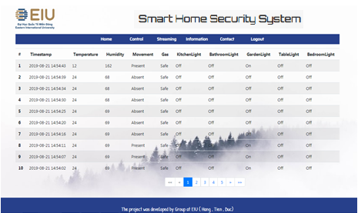
Results and Analysis
Web Application
Table Data Page

Slide 26
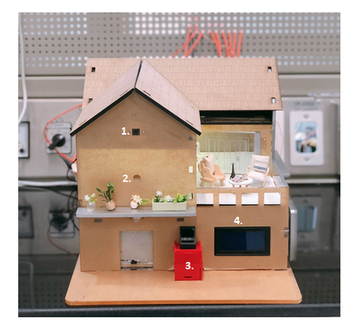
Results and Analysis
Result - Demo

Slide 27

Conclusion and Future Works
Conclusion
Project’s Achievements
Deploying a Web application for controlling and managing devices/funtions.
Streaming camera stream online video and display on Web application..
Delploying Smart Home Securirty System
(Recognizing face and fingerprint system to unlock the door. Autonomous sending Security message to mobile
phones, laptops and PCs ).

Slide 28



Conclusion and Future Works
Future Works
Voice control: Give command to turn on or off devices by speaking.
Controlling devices via mobile app: Create a mobile app which we can use to control our smart home (turn on and off lights, set on and off time…).
Emergency lights exit.
Set up an extra function in the security system.

Slide 29
Thanks for listening to our presentation!

